Slide 1
Python Training
Day 1
Ofir Iluz
29/12/2019

Slide 2
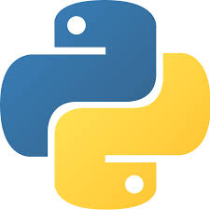
Guildaton Goals
Day 1
Get acquainted with python
Two cents on the interpreter
The language basics
Quick exercise
Linkedin course
Day 2
Summary of the Linkedin course
Advanced topics
Pip is love
Some more advanced topics
Extending the exercise

Slide 3
Guildaton Schedule
Day 1
09:30 – 13:00 – Python overview and basics
13:00 – EOD – Linkedin course
Day 2
09:30 – 12:30 – Course review and advanced topics
12:30 – 13:30 – Food
13:30 – 16:00 – More advanced topics and exercise
16:00 – 16:30 – Break
16:30 – EOD – Continue the exercise

Slide 4

Python in a slide
Python is an high level, interpreter based, general purpose programming language that was based on the ABC language that existed in 60’s
It was first released in 1991 and was created by a dutch programmer by the name of Guido van Rossum
Python’s main focus is on code reliability and readability, and it serves as both a procedural language, a functional language and an object orientated language, but is mainly known for its simplicity and ease of use for metaprogramming.
The language today is usually divided into two groups of users, the Python 2.x users and the Python 3.x users due to breaking changes in the language

Slide 5
Main Features of Python
Easy to learn, use and understand, and is free (open source)
An high level, expressive language
interpreter based, running on the fly, written in C
Compatible for different operating systems and easily portable
Has a wide variety of standard libraries for different uses as well as a huge community to extend the variety and satisfy your needs (no pun intended)
Has both dynamic types which are deduced at runtime by the interpreter and mixed types
Can be grouped into separate modules and packages easily
Easily extendable via other languages such as C/C++/Java, and most of the standard library is written in C and binded into python
It uses a ref-count cyclic garbage collector to handle the memory (completely automated, and be trigged and modified in-code)

Slide 6
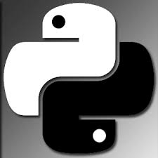
Downsides of Python
Python is not fast, it’s a dynamic language that requires a lot of resources for execution of each line
It is not a system language, since its very limited in memory control, nothing is straightforward and is very limited if you want to control and allocate your own memory space
It consumes quite a lot of memory unlike other languages while running
Since its an interpreter based dynamic language, most of its errors are runtime errors

Slide 7
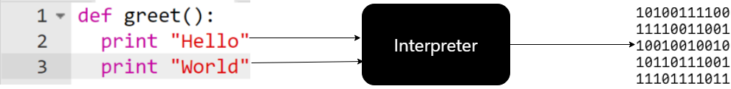
The Interpreter
Python’s runtime environment uses an interpreter instead of a compiler to create and run its code
It works in the following manner
The code gets parsed and tokenized into an abstract syntax tree representing an intermediate language, the language AST can be found in the following url:
https://github.com/python/cpython/blob/master/Parser/Python.asdl
The AST is analyzed to see if any grammatical errors occurred, and edits the AST to simplify and optimize it
Finally, the AST is fed into a generator which produces python’s VM byte code (a set of opcodes that the VM understands), which will afterwards be ran by the VM itself.

Slide 8

Enough talk, lets code!
Online IDE: www.repl.it

Slide 9
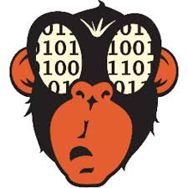
Enough talk, lets code!
While in the course we will use repl.it as our IDE. However in reality a good IDE to use would be Pycharm or VSCode
All of the code examples we will be using can be found in the following git repository with documentation:
https://github.com/ofiriluz/Python-Basics
Also, we will work with python 2.7 in the course.
After this brief introduction session, you will do a linkedin course to go over the basics of python in your own playground
The course can be found here:
https://www.linkedin.com/learning/python-essential-training-2
Time to python!

